Slide 1

Welcome to Web App Development
Welcome to Web App Development

Slide 2


What We’ll Be Talking About Today
Discuss Class Format
Grading Scheme
Key Objectives
Deliverables
Tools

Slide 3
Two Classes a Week
A Class with two parts
An instructional Lecture
Guided work time
Full Lab Day
Time to work on larger projects and Assignments

Slide 4
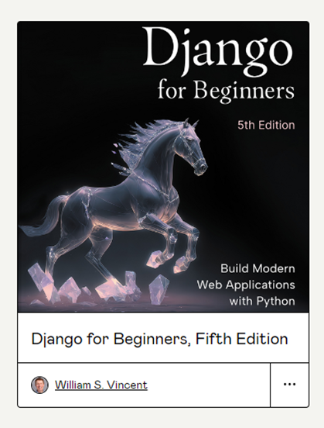
Our Book

Slide 5
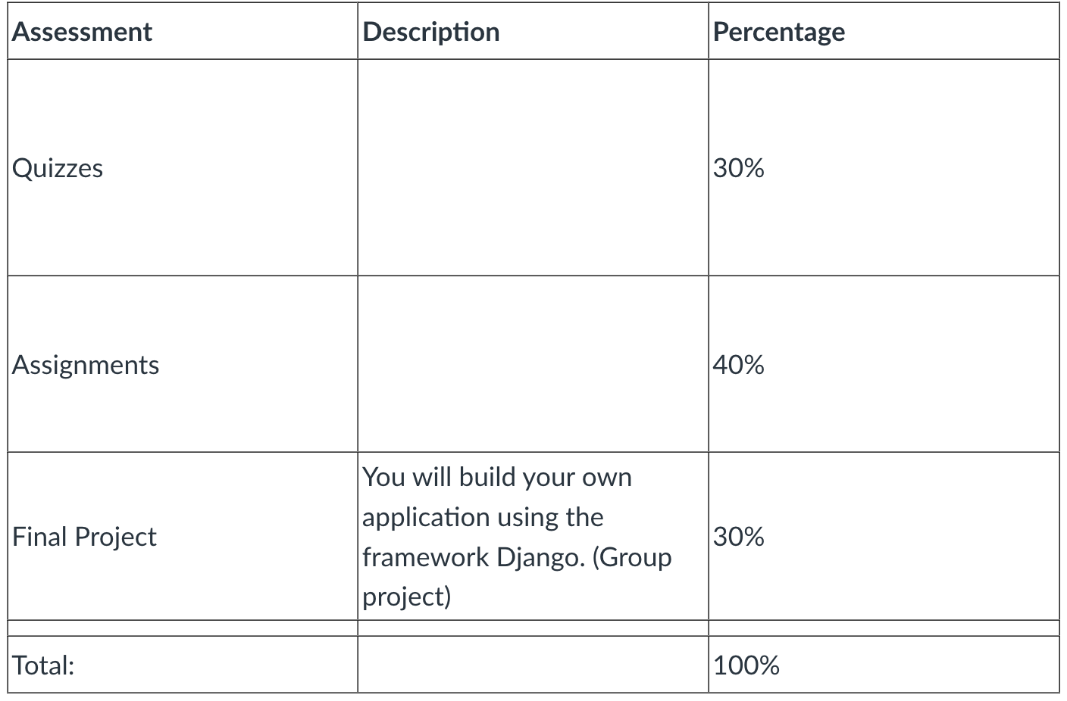
Grading Scheme

Slide 6

Course Learning Outcomes
Version Control
use version control to create and manage team projects.
SE Topics
be familiar with software engineering topics.
SD Processes
understand several software development processes (Agile, Waterfall).
Frameworks
be introduced to contemporary tools and frameworks.
Arch. Patterns
understand architectural patterns
Design Patterns
understand design patterns
Design and build
design and build a software project using a popular framework.

Slide 7
Deliverables
Small, book-based Assignments
Will be varied in complexity and size
~1-2 per week
Short, book-based Quizzes
~1-2 per week
One Large Group Project
Made up of Several Sprints and Final Submission
Includes a Presentation of Work

Slide 8
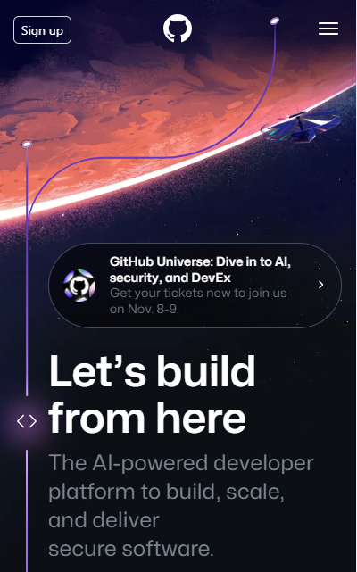
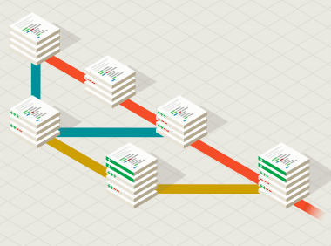
Tools- GitHub and Git SCM CLI Tools

Slide 9
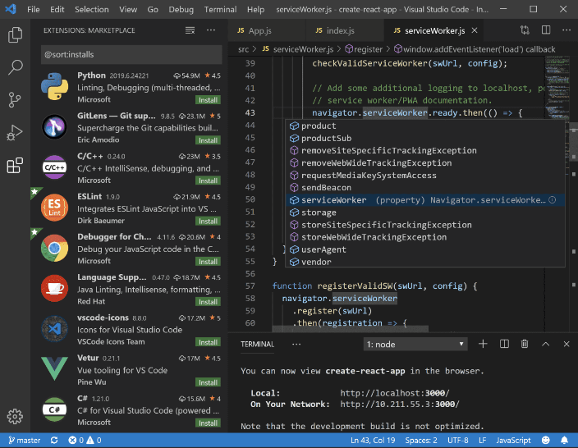
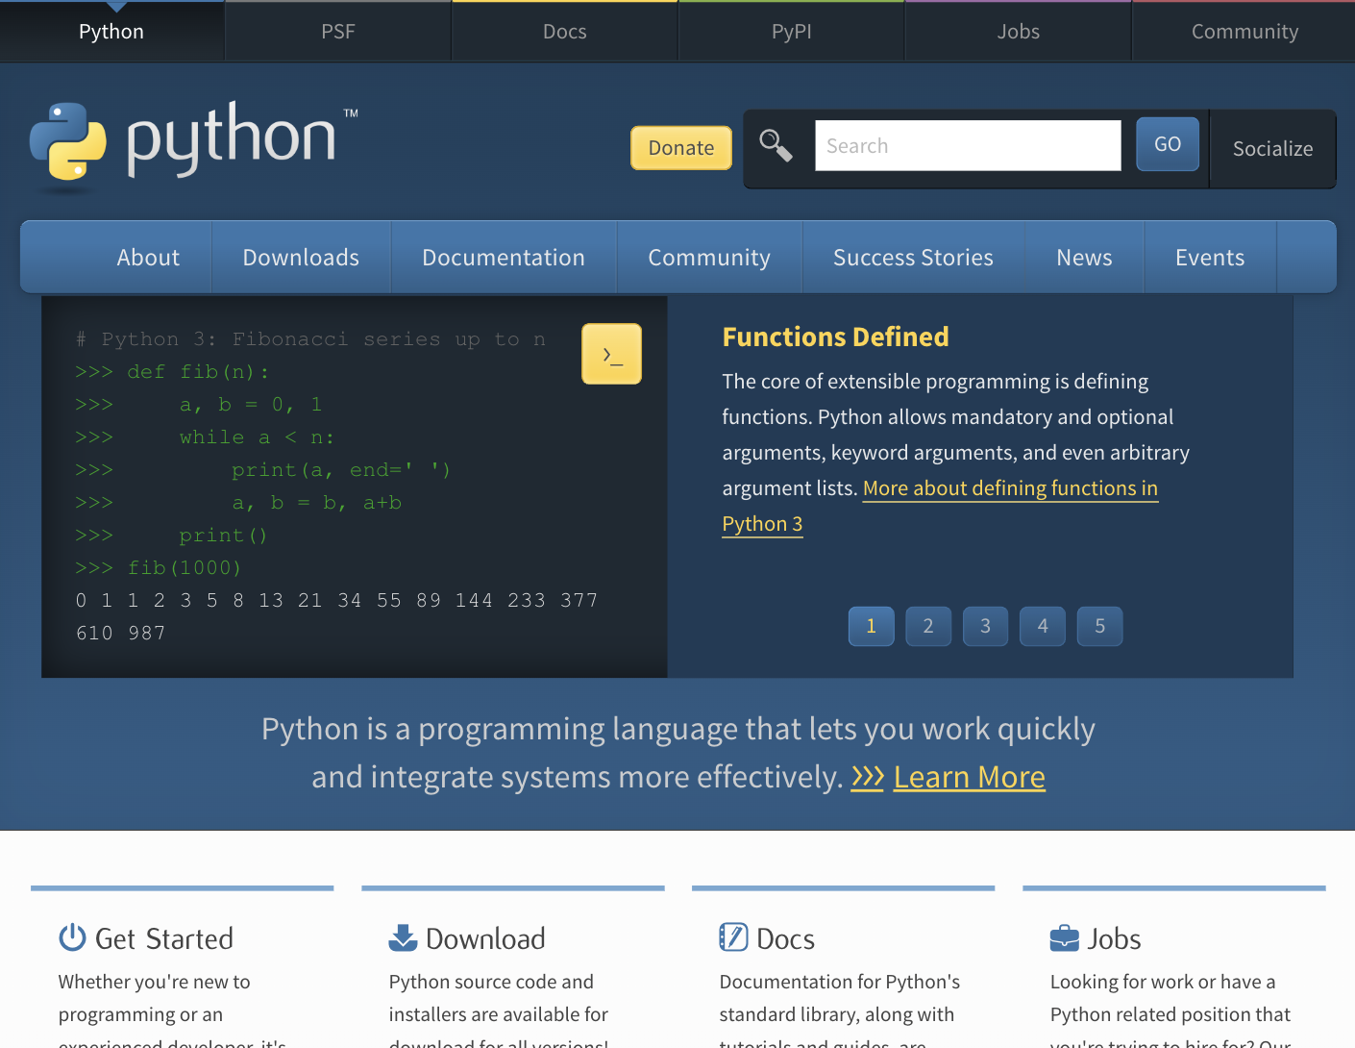
Tools – An Editor and Python

Slide 10
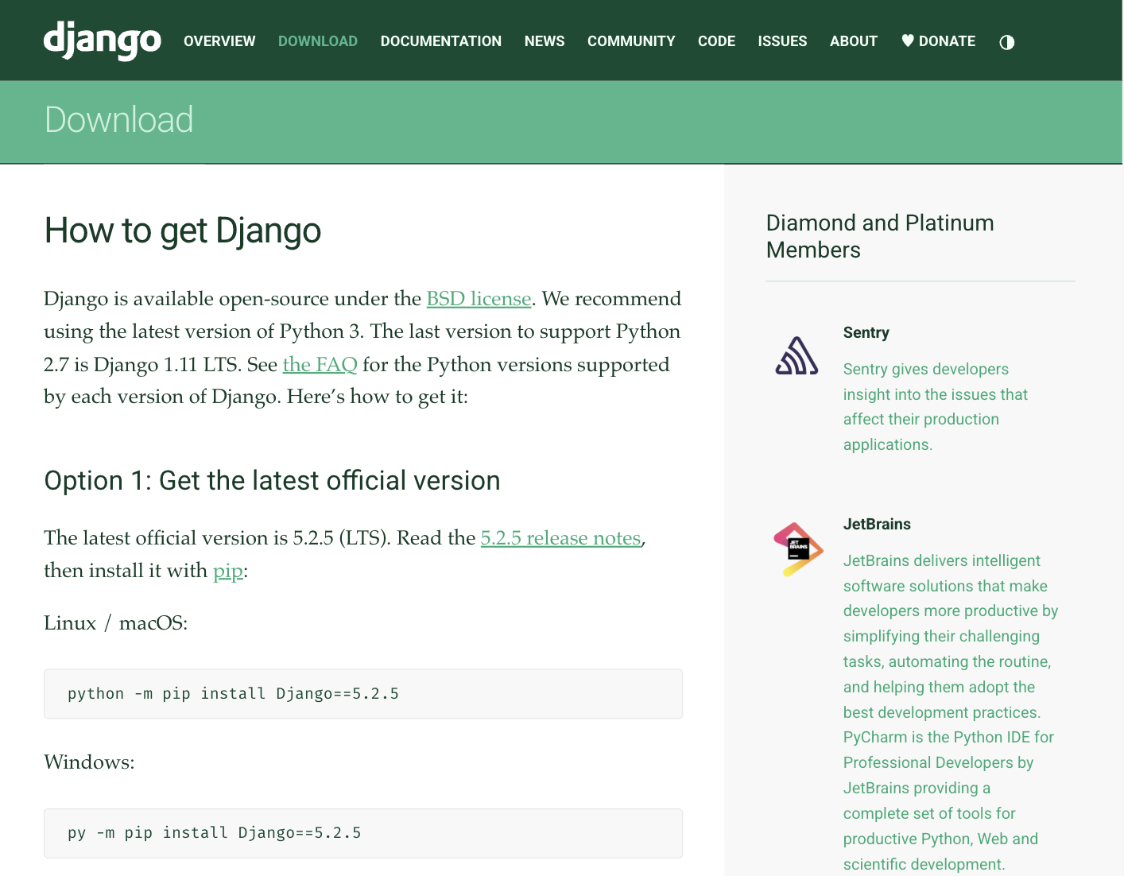

Tools - Django

Slide 11
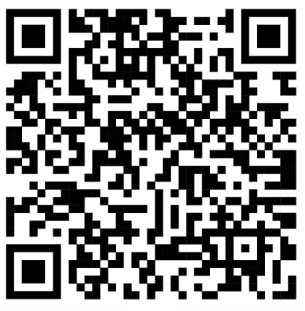
Discord
The department has a new Discord server, and we have a channel on it.
This will be a good place to ask questions, see announcements, and even join the class remotely when approved to do so.

Slide 12
Closing
Office Hours In SS-411:
Tu & Th 4pm – 5pm
Mon & Wed 2pm–3pm
Have a great first week and I’ll see you on Thursday!

